Slide 1
“An Experiment in Physics Can Never Condemn an Isolated Hypothesis but Only a Whole Theoretical Group”

Slide 2
Experiments
Application | Testing
Do not aim to prove/disprove existing theories Draw on existing theories Utilize instruments that are legitimized by the existing theories | Start with a new theory or aims to disprove existing theory Prediction of experimental fact Essential for the creation and development of science

Slide 3
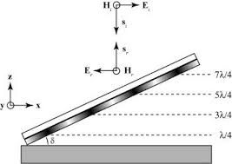

Slide 4
vs

Slide 5
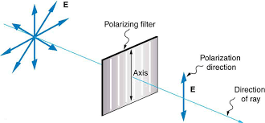
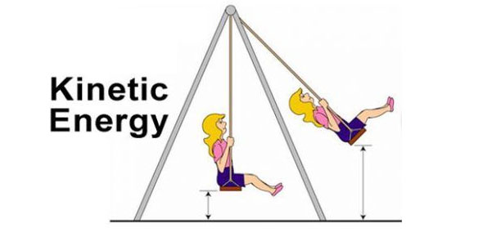

Slide 7
“A "Crucial Experiment" Is Impossible in Physics”

Slide 8
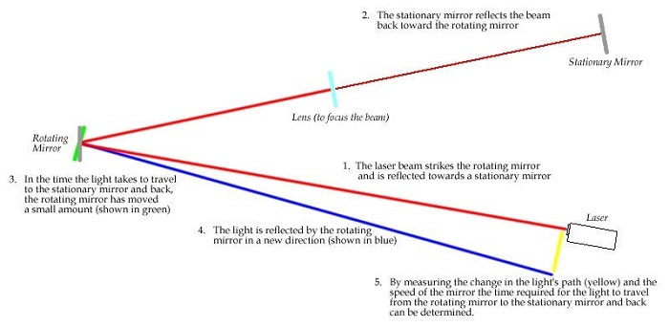

Slide 10
Closing Thoughts

