Slide 1
WHAT IS TECHNOLOGY?
(VAL DUSEK, 2006)

Slide 2
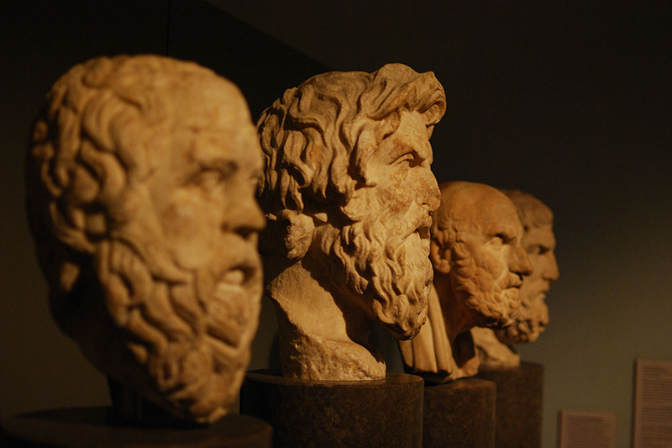
Are definitions important?

Slide 3
Real definition
Socrates/Plato/Aristotle
→Match the real nature of things
→Definitions as final goal of investigations
Stipulative definitions
Reportative
Definition
Close to the modern conception
Rejection of real essences
Anything can be defined as anything
Definitions as arbitrary choices
Definitions are introduced at the beginning of an investigation
Simply a report of how people use the word
Report accounts for different regions or social status
Similar to dictionary definitions
Précising Definition
Retains the core ordinary meaning of the word by describing range of application and cut-off points
Attempts to sharpen up boundaries of application
Philosophical attempts will be in this category

Slide 4
Real definition
Socrates/Plato/Aristotle
→Match the real nature of things
→Definitions as final goal of investigations
Stipulative definitions
Reportative
Definition
Close to the modern conception
Rejection of real essences
Anything can be defined as anything
Definitions as arbitrary choices
Definitions are introduced at the beginning of an investigation
Simply a report of how people use the word
Report accounts for different regions or social status
Similar to dictionary definitions
Précising Definition
Retains the core ordinary meaning of the word by describing range of application and cut-off points
Attempts to sharpen up boundaries of application
Philosophical attempts will be in this category

Slide 5
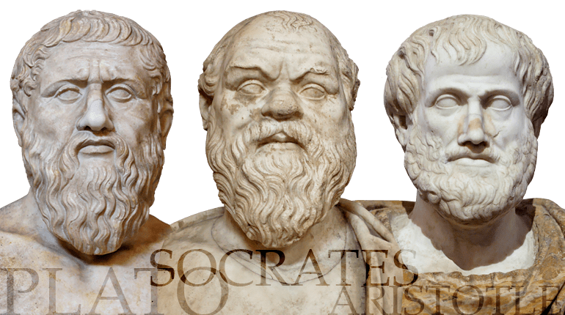
The notion of real definition
Plato (428–347 BCE), Socrates (470–399 BCE), Aristotle (384–322 BCE)

Slide 6
Real definition
Socrates/Plato/Aristotle
→Match the real nature of things
→Definitions as final goal of investigations
Stipulative definitions
Reportative
Definition
Close to the modern conception
Rejection of real essences
Anything can be defined as anything
Definitions as arbitrary choices
Definitions are introduced at the beginning of an investigation
Simply a report of how people use the word
Report accounts for different regions or social status
Similar to dictionary definitions
Précising Definition
Retains the core ordinary meaning of the word by describing range of application and cut-off points
Attempts to sharpen up boundaries of application
Philosophical attempts will be in this category

Slide 7
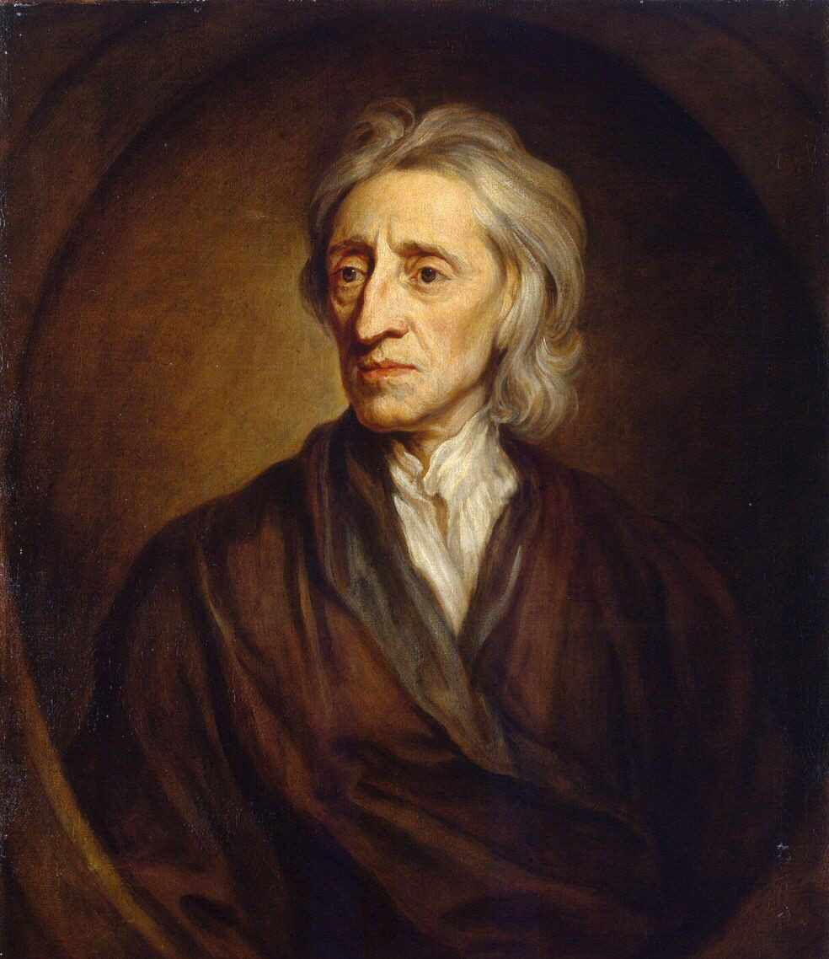
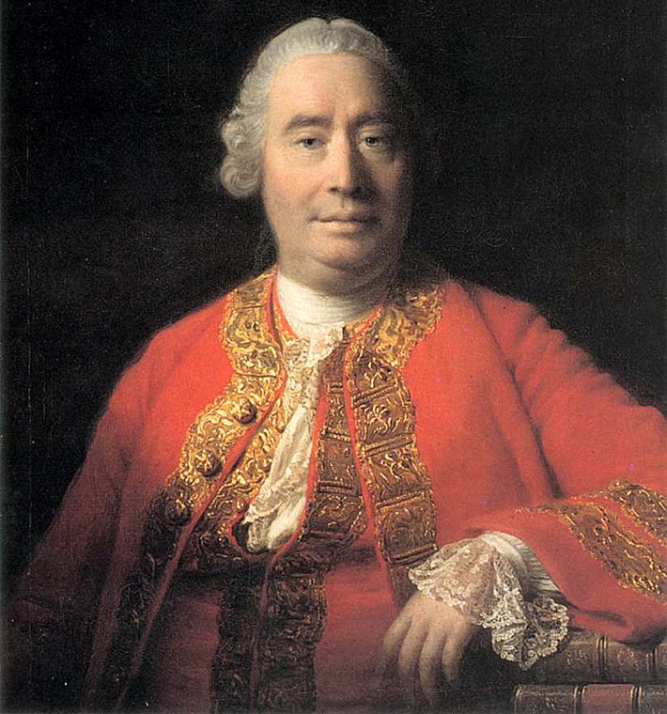
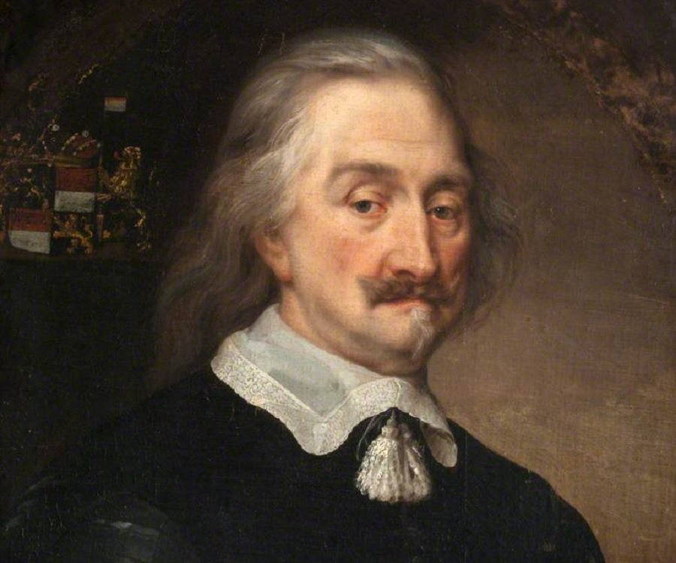
The notion of stipulative definitions
Thomas Hobbes (1588-1679)
David Hume (1711-1776)
Wiliam of Ockham (1285-1347)
John Locke (1632-1704)

Slide 8
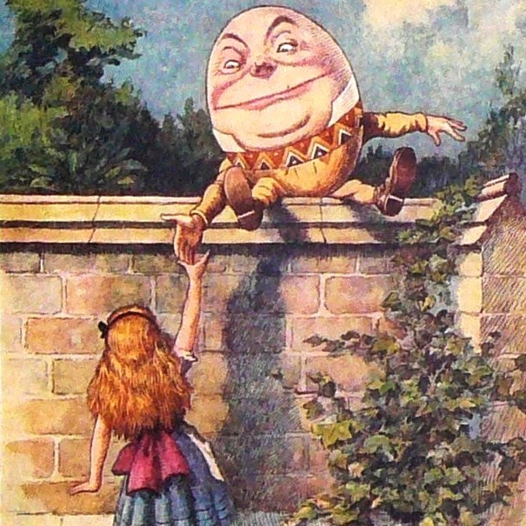
Humpty Dumpty (by Lewis Carroll)
«‘When I use a word,’ Humpty Dumpty said in rather a scornful tone, ‘it means just what I choose it to mean— neither more nor less.’ ‘The question is,’ said Alice, ‘whether you can make words mean so many different things.’ ‘The question is,’ said Humpty Dumpty, ‘which is to be master, that’s all.’» (Carroll, 1909, p. 103)

Slide 9
Real definition
Socrates/Plato/Aristotle
→Match the real nature of things
→Definitions as final goal of investigations
Stipulative definitions
Reportative
Definition
Close to the modern conception
Rejection of real essences
Anything can be defined as anything
Definitions as arbitrary choices
Definitions are introduced at the beginning of an investigation
Simply a report of how people use the word
Report accounts for different regions or social status
Similar to dictionary definitions
Précising Definition
Retains the core ordinary meaning of the word by describing range of application and cut-off points
Attempts to sharpen up boundaries of application
Philosophical attempts will be in this category

Slide 10
Reportative definition

Slide 11
Real definition
Socrates/Plato/Aristotle
→Match the real nature of things
→Definitions as final goal of investigations
Stipulative definitions
Reportative
Definition
Close to the modern conception
Rejection of real essences
Anything can be defined as anything
Definitions as arbitrary choices
Definitions are introduced at the beginning of an investigation
Simply a report of how people use the word
Report accounts for different regions or social status
Similar to dictionary definitions
Précising Definition
Retains the core ordinary meaning of the word by describing range of application and cut-off points
Attempts to sharpen up boundaries of application
Philosophical attempts will be in this category

Slide 12
Précising definition
Retains the core ordinary meaning of the word
Not simply reportative
Attempts to sharpen up boundaries of application of the word by describing the range of application and cut-off points
ANY philosophical attempt at a general definition of technology will be a précising definition

Slide 13
British empiricism
Ludwig Wittgenstein (1889-1951)

Slide 14
Guidelines for Definitions
Definitions should not be too broad or narrow
Definitions should not be circular
Definitions should not use figurative language or metaphors
Definitions should not be used solely negative but should be in positive terms

Slide 15
Technology as hardware
T. as tools and machines
Most obvious definition
Problem: cases where technology didn’t use tools/machines
3
DEFINITIONS OF TECHNOLOGY
Technology as rules
Technology as system
«Software» vs. «Hardware»
T. involves patterns of means-end relationships
→ Means-end patterns systematically developed
→ Technological system: hardware + human skills and organization needed to operate & maintain the system

Slide 16
Technology as hardware
T. as tools and machines
Most obvious definition
Problem: cases where technology didn’t use tools/machines
3
DEFINITIONS OF TECHNOLOGY
Technology as rules
Technology as system
«Software» vs. «Hardware»
T. involves patterns of means-end relationships
→ Means-end patterns systematically developed
→ Technological system: hardware + human skills and organization needed to operate & maintain the system

Slide 17
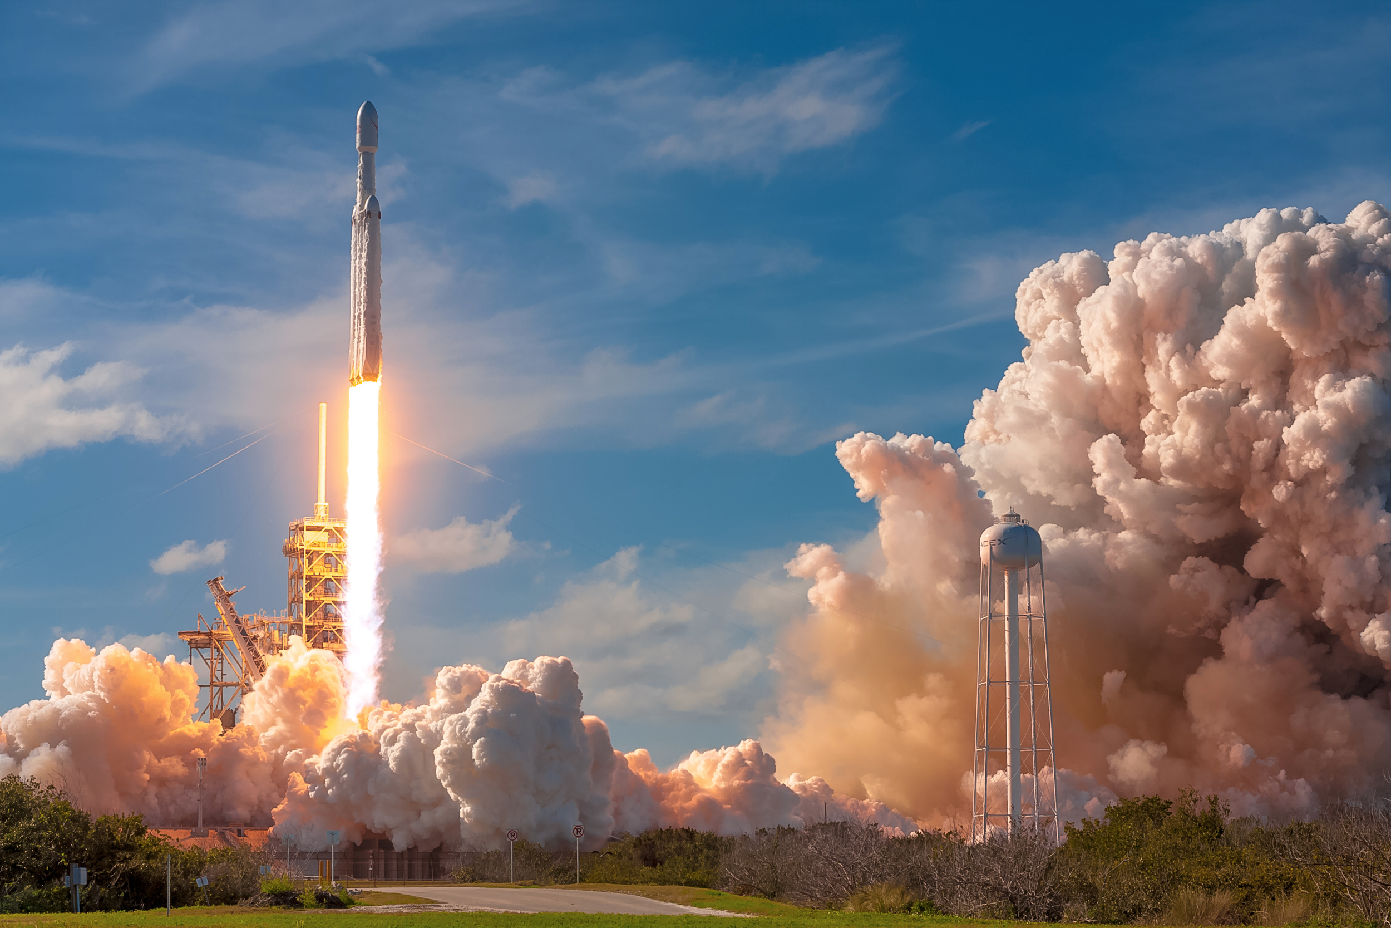
Technology as hardware

Slide 18
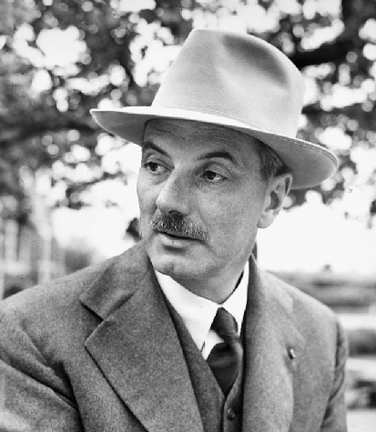
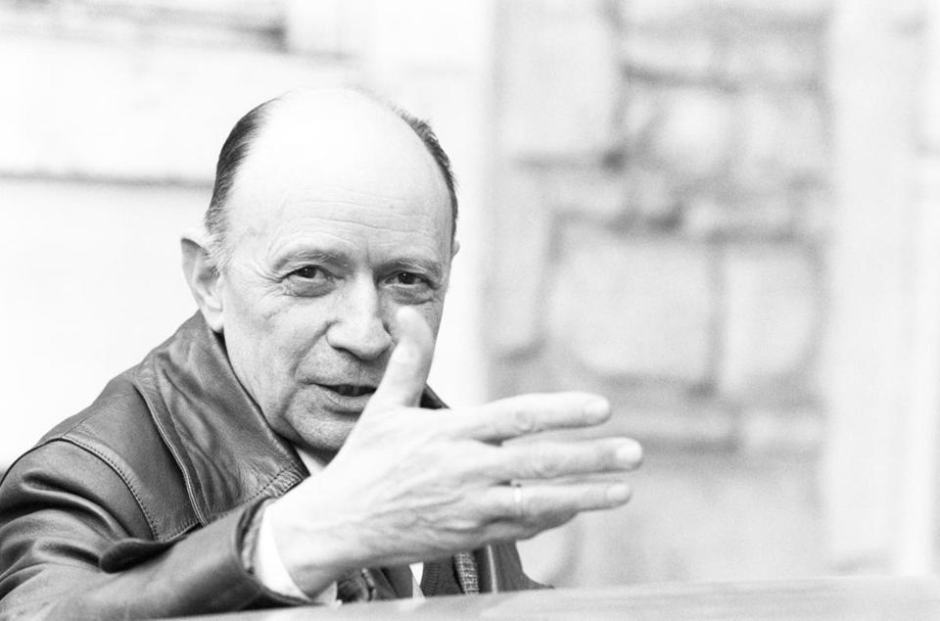
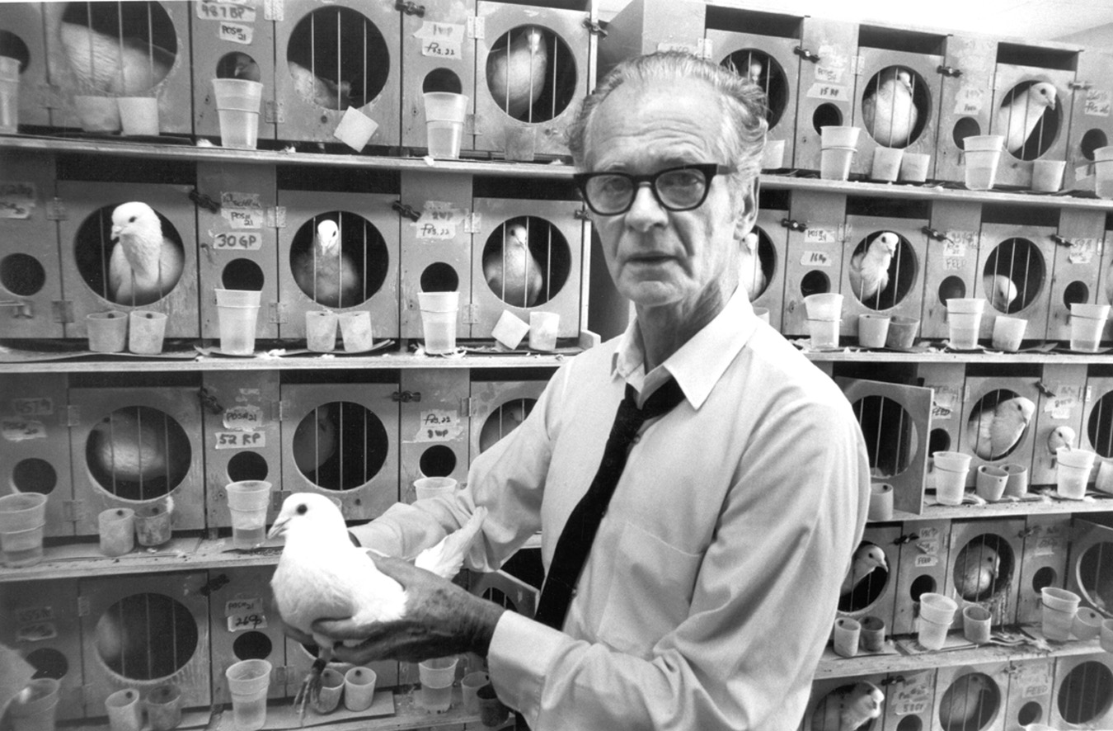
Technology as hardware - Limitations
B. F. Skinner (1904-1990)
Lewis Mumford (1895-1990)
Jacques Ellul (1912-1994)
Behavioral technology
Megamachines
Patterns of rule-following behavior / «Technique»

Slide 19
Technology as hardware
T. as tools and machines
Most obvious definition
Problem: cases where technology didn’t use tools/machines
3
DEFINITIONS OF TECHNOLOGY
Technology as rules
Technology as system
«Software» vs. «Hardware»
T. involves patterns of means-end relationships
→ Means-end patterns systematically developed
→ Technological system: hardware + human skills and organization needed to operate & maintain the system

Slide 20
Technology as rules
Means-end patterns systematically developed

Slide 21
Technology as hardware
T. as tools and machines
Most obvious definition
Problem: cases where technology didn’t use tools/machines
3
DEFINITIONS OF TECHNOLOGY
Technology as rules
Technology as system
«Software» vs. «Hardware»
T. involves patterns of means-end relationships
→ Means-end patterns systematically developed
→ Technological system: hardware + human skills and organization needed to operate & maintain the system

Slide 22
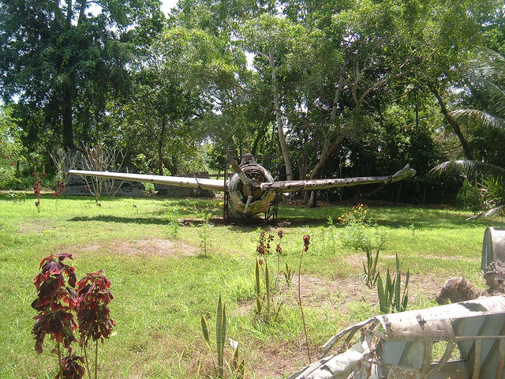
Technology as a system

Slide 23
Technology as Applied Science
Much of contemporary technology is applied science
Historically inaccurate:
Science as combination of controlled experiments with mathematical laws of nature is only some hundred years old
Prehistoric technology dates back to the stone tools of earlies humans millions of years ago
Systematically inaccurate:
Many discoveries were not a direct application of scientific theories to achieve pre-assumed goals: invention of penicillin, invention of post-its, inventions by Thomas Edison
Many discoveries were only the product of trial and error
→ Notion of technology as applied science is too narrow

Slide 24
Systems Definition
Technology is:
“the application of scientific or other knowledge to practical tasks by ordered systems that involve people and organizations, productive skills, living things, and machines.”

Slide 25
Systems Definition
“the application of scientific or other knowledge to practical tasks by ordered systems that involve people and organizations, productive skills, living things, and machines.”
Technology as applied science
Technology as a rule
Technology as a system
Technology as a hardware

Slide 26
Systems Definition
Technological system:
Complex of hardware (also plants and animals), knowledge, inventors, operators, repair people, consumers, marketers, advertisers, government administrators and others involved in technology

Slide 27
Pictures sources
https://sohopress.com/10-books-that-show-what-happens-when-technology-goes-awry/
https://www.kent.ac.uk/courses/undergraduate/14/war-and-conflict
https://www.isu.edu/english/programs/philosophy/
https://brewminate.com/social-norms-in-the-courts-of-ancient-athens/
https://traveltrales.wordpress.com/2012/05/29/romans-royalists-humpty/
https://marketingland.com/customers-speaking-language-matter-154723?utm_keyword=zootrock
https://www.theodysseyonline.com/push-your-boundaries
https://www.greecehighdefinition.com/blog/2017/12/6/socrates-plato-and-aristotle-the-big-three-in-greek-philosophy
http://stendhalgallery.com/?page_id=5341
https://www.thefamouspeople.com/profiles/thomas-hobbes-205.php
https://quotesgram.com/quotes-john-locke-liberalism/
http://www.philosophers.co.uk/david-hume.html
https://marketingland.com/talk-human-time-brands-get-real-145728
https://www.theparisreview.org/blog/2015/03/05/wittgenstein-schoolteacher/
https://arstechnica.com/science/2018/07/the-year-2020-could-see-the-unheard-of-debut-of-four-big-rockets-or-not/
https://new.evolution-institute.org/wp-content/uploads/2015/04/BFSkinner.jpg
https://www.babelio.com/auteur/Lewis-Mumford/132925
https://www.bostonglobe.com/ideas/2012/07/07/jacques-ellul-conference/1BVZp8uEiGKoeXAmkDJpeO/story.html
https://freerangestock.com/photos/65197/brain-connections--creativity-and-intelligence-concept.html
https://islandculturearchivalsupport.wordpress.com/2018/10/05/ww-ii-oral-history-project-in-png/

Slide 28
Literature
Dusek, V. (2006). Philosophy of technology: An introduction. Malden MA: Blackwell.
Carroll, L. (1909) Through the looking-glass and what Alice found there [Pdf]. New York: Dodge publishing company. Retrieved from the Library of Congress, https://www.loc.gov/item/09016128/

