Slide 1
Irreducible Complexity:
a single system that is necessarily composed of several well-matched, interacting parts that contribute to the basic function, and where the removal of any one of the parts causes the system to effectively cease functioning

Slide 2
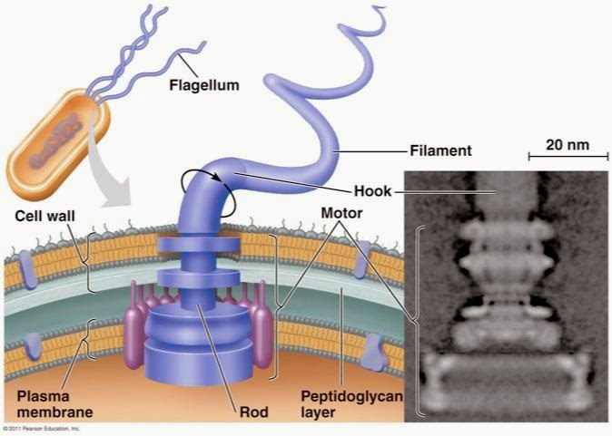
A sketch of the intelligent design hypothesis
The flagellum can be thought of as an outboard motor that bacteria use to swim
First truly rotary structure discovered in nature.
In absence of any of the proteins the system ceases to function

Slide 3
Intelligent Design and Evolution
No quarrel between ID and Evolution per se
Explains what Darwin’s theories fail to explain
Mechanism of evolution (i.e. how did all this happen, by natural selection or by purposeful Intelligent Design?)
Opposition to Behe’s theory stems from the philosophical and theological implications that his theory has
Quantum events such as radioactive decay are not governed by causal laws
→ Influencing such events would break no laws of nature

Slide 4
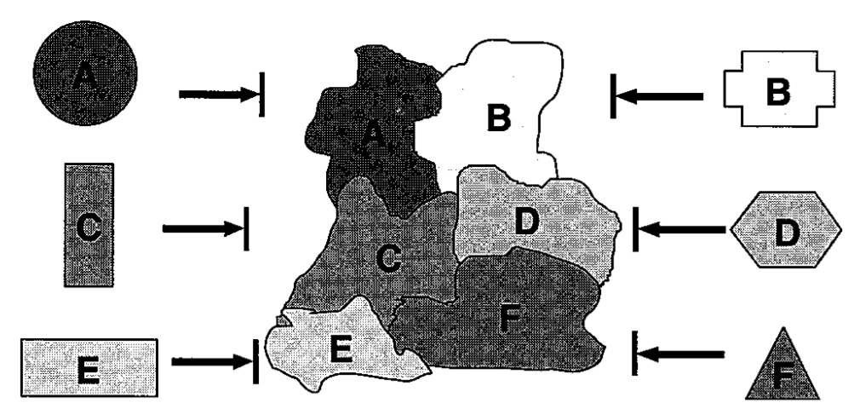
Misconceptions concerning supposed ways around the irreducibility of biochemical systems
This drawing emphasizes that even if individually acting proteins homologous to parts of a complex originally had separate functions, their surfaces would not be complementary to each other
Thus problem of irreducibility remains, even if individual proteins homologous to system components separately and originally had their own functions
Kenneth Miller has pointed to the redundancy of the cilium as a counterexample to the claim of its irreducibility (Miller 1999, 140-3). But redundancy only delays irreducibility; it does not eliminate it.
Irreducible complexity focuses on the functioning of the system (not on the misc. functions of the individual components)

Slide 5
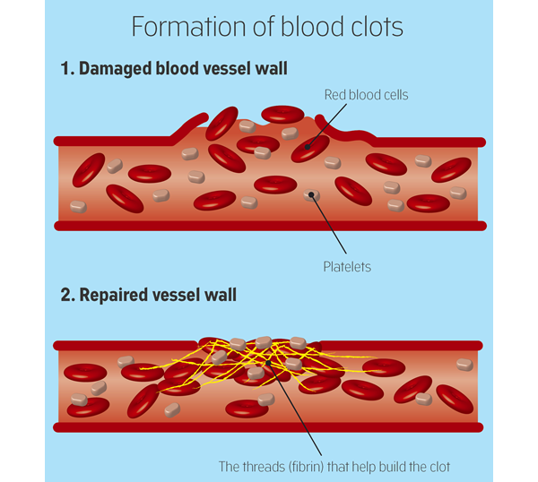
The blood clotting cascade
Plasminogen deficiency leads to a suite of symptoms - thrombosis, ulcers, and high mortality.
Fibrinogen deficiency leads to an inability to clot, hemorrhaging, and death of females during pregnancy.
Mice missing both genes were "rescued" from the ill effects of plasminogen deficiency only to suffer the problems associated with fibrinogen deficiency.
“irreducible complexity seems to be a much more severe problem than Darwinists recognize, since the experiment Doolittle himself chose to demonstrate that "music and harmony can arise from a smaller orchestra" showed exactly the opposite”

Slide 6
Future prospects of the intelligent design hypothesis
The idea of lntelligent Design arose not from the work of any individual but from the collective work of biology, particularly in the last fifty years.
The cell is not getting any simpler; it is getting much more complex. And as imagined simplicity vanishes, the idea of intelligent design becomes more and more compelling. That trend is continuing inexorably

