Slide 1
LATOUR
Actor-Network Theory

Slide 2
Latour – Goals
Show why the social cannot be defined as a type of material
Dispute the project of providing ‘social explanations’ of other states of affair
Redefine the notion of ‘social’

Slide 3
Two Approaches
Sociology of the social | Second approach
Advances the existence of ‘society’, ‘social dimension’ | Nothing specific to social order
‘Social context’: separated domain of reality in which non-social activities take place | No ‘social context’, no distinct domain of reality to which the label ‘social’ or ‘society’ could be attributed
‘Social’: possesses some specific properties | -
Separated domain can be used to Explain specifically social phenomena Explain ‘social aspects’ of other non-social domains | No ‘social force’ available to explain the residual features other domains cannot account for
‘Social’ is the glue that can fix everything
Ordinary agents embedded in the social world (‘informants’). Fully visible only to social scientist | Actors know what they’re doing, more than ‘mere informants’ → No meaning in adding social factors to other scientific specialties

Slide 4
Two Approaches
Sociology of the social | Sociology of associations
Advances the existence of ‘society’, ‘social dimension’ | No ‘social dimension’
‘Social context’: separated domain of reality in which non-social activities take place | No distinct domain of reality to which the label ‘social’ or ‘society’ could be attributed.
‘Social’: possesses some specific properties | -
Separated domain can be used to Explain specifically social phenomena Explain ‘social aspects’ of other non-social domains | No ‘social force’ available to explain the residual features other domains cannot account for
‘Social’ is the glue that can fix everything | ‘Social’ is what is glued together by many other types of connectors
Ordinary agents embedded in the social world (‘informants’). Fully visible only to social scientist | Actors know what they’re doing, more than ‘mere informants’ → no meaning in ‘adding social factors’

Slide 5
Etymology of social
(→ socius)
Something homogeneous
Social ties
Trail of associations between heterogeneous elements
social
Science of the social
Tracing of associations
sociology
Sociology of the social
Sociology of associations

Slide 6
Latour’s definition of social
Sociology as tracing of associations comprehends any type of aggregate
Heterogeneous elements might be assembled anew in some given state of affairs
Need to reshuffle the conception of what was associated together
Sense of belonging enters a crisis
→ New notion of social: much wider than usual, but strictly limited to tracing new associations and to designing their assemblage
“not as a special domain, a specific realm, or a particular sort of thing, but only as a very peculiar movement of re-association and reassembling”

Slide 7
Sociology of Associations
Activities might be linked in a way that does or does not produce a society
Social explanation is counterproductive
Associations are made of non-social ties
Actors have task of defining and ordering the world
Let actors deploy the full range of controversies in which they are immersed
Social scientist should “follow the actors”
Social is only visible by the traces it leaves when new association is being produced between non-social elements
Fully relativist: ability to move between frames of reference

Slide 8
When prefer one, when the other
Sociology of the Social
Indispensable in most situations: shorthands designate ingredients already accepted in the collective realm
Fixed frame of reference (pre-relativist) works for slowly evolving situations
Sociology of Associations
“situations where innovations proliferate, where group boundaries are uncertain, when the range of entities to be taken into account fluctuates”

Slide 9
Sociology of the Social (common sense) | Sociology of Associations
Advances the existence of ‘society’, ‘social dimension’ | No ‘social dimension’
‘Social context’: separated domain of reality in which non-social activities take place | No ‘social context’, no distinct domain of reality to which the label ‘social’ or ‘society’ could be attributed
Social aggregate exists behind activites [law, science, …] | Nothing behind activities. Activities may be linked in a way that does or does not produce a society
‘Social’ if possesses specific properties | ‘social’ as a very peculiar movement of re-association and reassembling. Visible only by the traces it leaves when a new association is being produced between non-social elements
‘Social’ is glue that can fix everything | ‘Social’ is what is glued together by many other types of connectors
Separated domain can be used to Explain specifically social phenomena Explain ‘social aspects’ of other non-social domains | No ‘social force’ available to explain the residual features other domains cannot account for
Ordinary agents embedded in the social world (‘informants’). Fully visible only to social scientist | Actors know what they’re doing, more than ‘mere informants’ → Task of defining and ordering the social world
Method: Settle controversies | Method: let actors deploy the full range of controversies in which they are immersed
Society made of social ties | Associations are made of non-social ties
Pre-relativist: fixed frame of reference | Fully relativist: ability to move between frames of reference
Social scientists impose some order & limits, teach actors what they are, add reflexivity to actors’ blind practice. | Social scientists ‘follow the actors’ & travel wherever new heterogeneous associations are made
Convenient shorthand of the social | Costly longhand of associations
Explanation begins with society | Explanation ends with society
Optimal for: most situations and situations evolving slowly | Optimal for: active, warm, extreme situations

Slide 10
Sokal & Bricomont
Fashionable Nonsense

Slide 11
Frame of reference (physics)
= Scheme for assigning spatial and temporal coordinates (x,y,z,t) to “events”
e.g. Event in NYC: 6th Avenue (x), 42nd Street (y), 30 meters above ground level (z), at noon on May 1, 1998 (t).
Origin and orientation are arbitrary
Relativity theory: two frames in relative motion
Frame of reference can be a set of observers

Slide 12
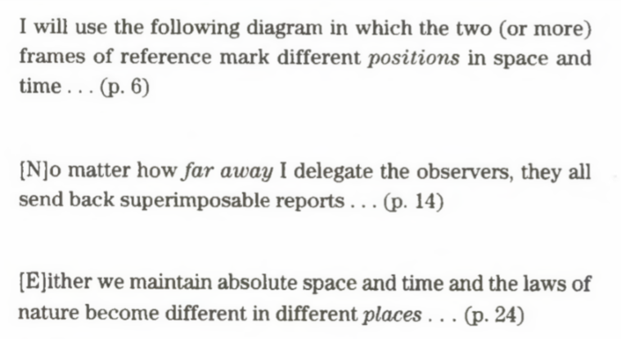
Misunderstandings (1/3)
Thinks relativity is concerned with the relative location (rather than relative motion)

Slide 13
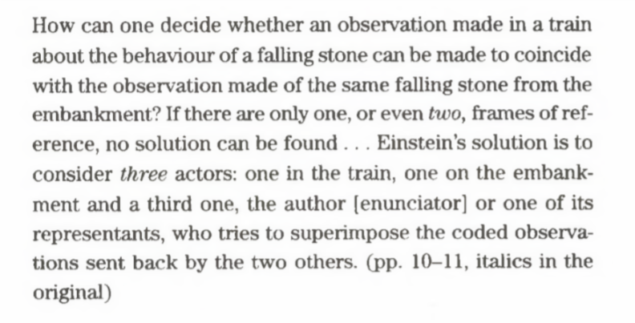
Misunderstandings (2/3)
Thinks 3rd frame of reference is crucial. Also, stresses need to discipline human observers

Slide 14
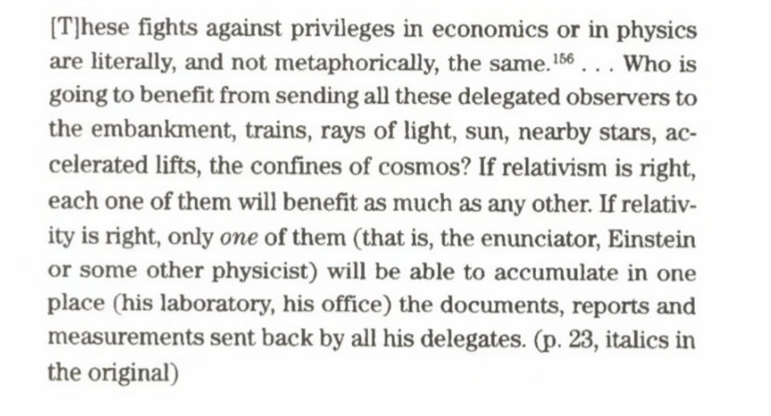
Misunderstandings (3/3)
Emphasizes alleged role of the ‘enunciator’ (reference frame with privileged role) → distinction between “relativism” and “relativity”

Slide 15
Mermin’s response (on Physics Today)
Semiotic reading, transferrable to society/social science
Sokal: learned anything transferrable to society?
Purely logical level: no
Sociologists do not have background in physics

