Slide 1
Program for today‘s session
Course website, program & examination content
What are STS?
Why study S&T?
In-session reading of Okasha 2002 & task.

Slide 2
Grading criteria
The following criteria will be applied in the grading of written contributions
Ability to express discussed content/one‘s own thoughts clearly and precicely
Argumentative consistency
Capacity to independent critical reflection

Slide 3


Warning
Everything to be discussed is controversial!

Slide 4
Why study S&T?
The impact and importance of S&T in modern society.
In many public debates, some notion of S&T is presupposed.
Different disciplines have different approaches and standards. Perspectives from “within” can lead to restricted views of science.
Science plays an influential role as an institution in modern society. That role needs justification.

Slide 5
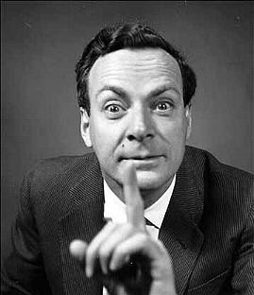
Philosophy of science is about as useful to scientists as ornithology is to birds.
Attributed to
Richard Feynman

Slide 6
Types of Inferences
Deduction
All the beans in this bag are white
These beans are from this bag
-------------------------------------------------
These beans are white
Properties:
The truth of the premises warrants the truth of the conclusion.
In a deductively valid argument, it is impossible that the premises are true and the conclusion is false.
Logically necessary
Not ampliative (“analytic”)
A deductive argument is called „sound“ if its premises happen to be true.
Induction
These beans are white
These beans are from this bag
-------------------------------------------------
All the beans in this bag are white
Properties:
The truth of the premises does not warrant the truth of the conclusion.
It is possible that the premises are true and the conclusion is false.
Not necessary
Ampliative (”synthetic”)
Abduction
(Peirce: „Hypothesis“)
All the beans in this bag are white
These beans are white
-------------------------------------------------
These beans are from this bag
Properties:
The truth of the premises does not warrant the truth of the conclusion.
It is possible that the premises are true and the conclusion is false.
Not necessary
Ampliative (”synthetic”)
The conclusion „explains“ the premises.
Inference to the best explanation
C. S. Peirce, Deduction, Induction, Hypothesis (1878)

Slide 7
Hume on Causality
„Here is a billiard-ball lying on the table, and another ball moving towards it with rapidity. They strike; and the ball, which was formerly at rest, now acquires a motion. This is as perfect an instance of the relation of cause and effect as any which we know, either by sensation or by reflection. Let us therefore examine it. ’Tis evident, that the two balls touched one another before the motion was communicated, and that there was no interval betwixt the shock and the motion. Contiguity in time and place is therefore a requisite circumstance to the operation of all causes. ’Tis evident likewise, that the motion, which was the cause, is prior to the motion, which was the effect. Priority in time, is therefore another requisite circumstance in every cause. But this is not all. Let us try any other balls of the same kind in a like situation, and we shall always find, that the impulse of the one produces motion in the other. Here therefore is a third circumstance, viz., that is a constant conjunction betwixt the cause and effect. Every object like the cause, produces always some object like the effect. Beyond these three circumstances of contiguity, priority, and constant conjunction, I can discover nothing in this cause. The first ball is in motion; touches the second; immediately the second is in motion: and when I try the experiment with the same or like balls, in the same or like circumstances, I find that upon the motion and touch of the one ball, motion always follows in the other. In whatever shape I turn this matter, and however I examine it, I can find nothing farther.“
An Enquiry Concerning Human Understanding, Abstract of a Treatise of Human Nature (1748)

Slide 8
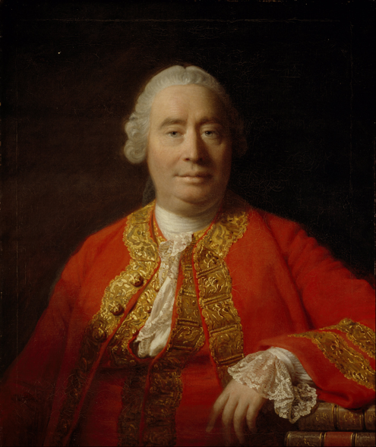
David Hume and the Problem of Induction
Reasoning that goes beyond past and present is based on cause and effect
The relation of causality:
1) constant conjunction
2) contiguity
3) priority in time (of the cause)
4) NO necessary connection!!!!
David Hume
1711–1776
The Problem of Induction:
How can inferences from the past/present to the future (or from observed instances to unobserved instances) be justified?

Slide 9
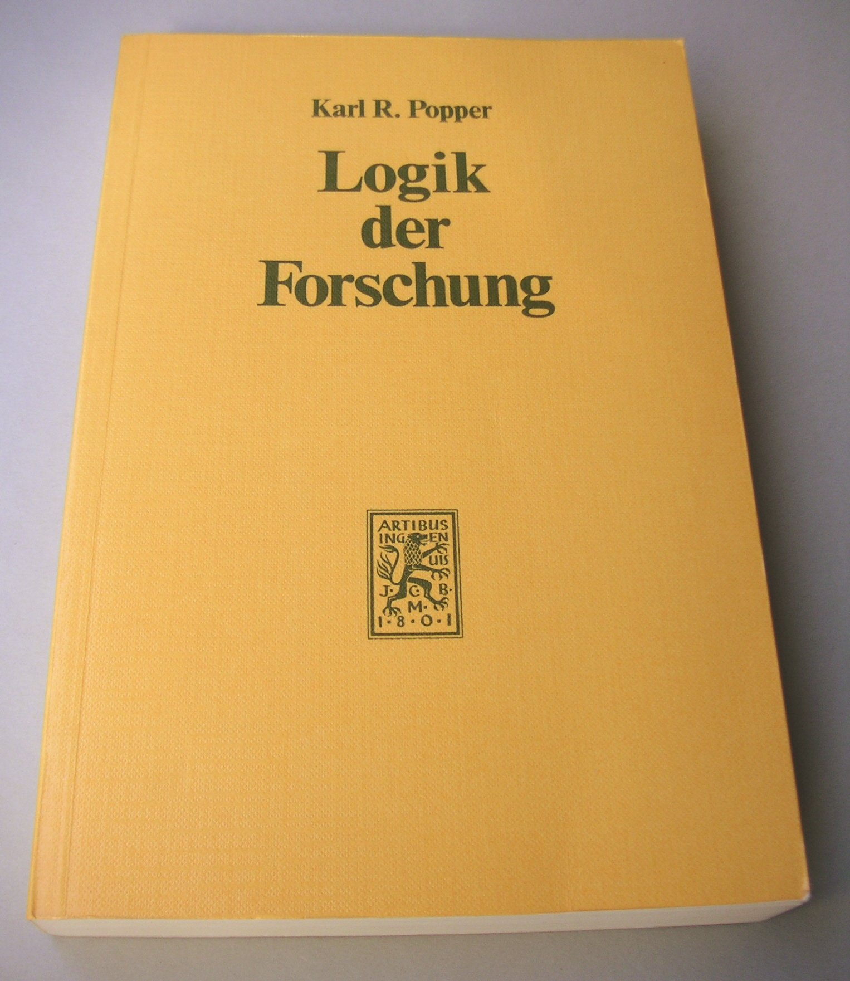
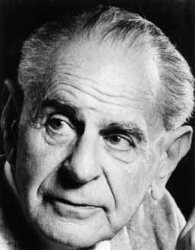
Karl Popper’s (Dis)solution of the Problem of Induction in
The Logic of Scientific Discovery (1934)
Karl R. Popper
1902–1964

Slide 10
Popper, Logic of Scientific Discovery Ch. 1
The Problem of Induction
Induction
An inference that „passes from singular statements (sometimes also called ‘particular’ statements), such as accounts of the results of observations or experiments, to universal statements, such as hypotheses or theories“ (p. 3f.)
The Problem of Induction
„ The question whether inductive inferences are justified, or under what conditions […].“ (p.3)
The Principle of Induction
A principle that would allow us to justify inductive inferences.
Examples: Hume‘s uniformity of nature.
The principle of induction has to be a synthetic sentence, i.e. ist negaation must be logically possible.
Problem: The principle of induction can only be justified inductively.
➔ infinite regress!
A modification of the principle by reference to the probability does not avoid the regress.
Popper’s Method of Deductive Testing
Prerequisite: elimination of psychologism. Distinction between the psychology of knowledge (context of discovery) and logic of knowledge (context of justification).
Principle: „From a new idea, put up tentatively, and not yet justified in any way—an anticipation, a hypothesis, a theoretical system, or what you will—conclusions are drawn by means of logical deduction.” (p. 9)
4 lines of theory testing:
Logical comparison of conclusion (consistency)
Logical form of the theory (empirical content)
Comparison with other theories
Testing by way of empirical application
➔ asymmetry between verifiability and falsifiability!
- Corroboration (tentative)
- Falsification (definitive)
„It should be noticed that a positive decision can only temporarily support the theory, for subsequent negative decisions may always overthrow it. So long as theory withstands detailed and severe tests and is not superseded by another theory in the course of scientific progress, we may say that it has ‘proved its mettle’ or that it is ‘corroborated’ by past experience “ (p. 10)
„Nothing resembling inductive logic appears in the procedure here outlined. I never assume that we can argue from the truth of singular statements to the truth of theories. I never assume that by force of ‘verified’ conclusions, theories can be established as ‘true’, or even as merely ‘probable’. (p. 10)

Slide 11
Psychology
Singular (observational) Statements
O₁, O₂ ... O_{n}
All ...
Every ...
General Statement
(Theory, Model)
Corroboration
C
Falsification
D
C₁, C₂ ... C_{n}
Observational Consequences
Logic!

Slide 12
Sismondo Ch. 1: A common view of science
Dominates popular views of science & serves as a „mythic“ framework for scientists
S. as a formal activity (systematic method)
S. accumulates knowledge
S. confronts the natural world directly
S. is progressive
S. is objective
S. produces truths about the natural world (realism)
S. produces authorative knowledge
S. is elitist (participation in S. requires expertise)
Includes a intuitive distinction between “hard” sci. and the rest

Slide 13
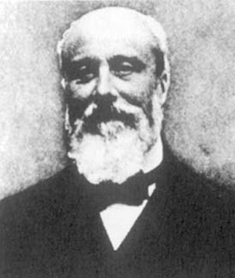
Important works
Les théories électriques de J. Clerk Maxwell, 1900
L´évolution de la mécanique, 1902
Sozein ta phainomena. Essai sur la théorie physique de Platon à Galilée, 1908
La théorie physique, son objet, sa structure, 1906
Le système du monde, histoire des doctrines cosmologiques de Platon à Copernic, 1913-1959
Duhem‘s holism
“In sum, the physicist can never subject an isolated hypothesis to experimental test, but only a whole group of hypotheses; when the experiment is in disagreement with his predictions, what he learns is that at least one of the hypotheses constituting this group is unacceptable and ought to be modified; but the experiment does not designate which one should be changed.”
The Aim and Structure of Physical Theory, p.187
Pierre Duhem
1861-1916

Slide 14
Sismondo, Chapter 9: Two Questions about Technology
Is Technology Applied Science?
The linear model: Tech. is the applied extension of sci.
  “A rhetorical tool”
  Tech. knowledge downplayed, autonomy of tech. knowledge; sci.tists invent and inventors do sci.
  Sci. and tech. not sufficiently distinct; causal dependence between sci. and tech.: Actor-Network-Theory, Technoscience
  “The linear model … is dead” (Rosenberg 1994).

Slide 15
Sismondo, Chapter 9: Two Questions Concerning Technology
Does Technology Drive History?
Tech. determinism: Material forces, tech. in particular, determine social events.
  Engels; Marx: “The hand-mill gives you society with the feudal lord, the steam-mill society with the industrial capitalist.”
  Artifacts produced to achieve political goals (Winner 1986)
Against tech. determinism: Non-essentialism (tech.ies do not have essential features)
  Social Construction of Technology SCOT (Pinch & Bijker 1987)
  interpretive flexibility; examples: the standard modern bicycle; the Luddites (Grint & Woolgar 1997)
  Success of tech. depends on the group that takes it up and promotes it
  “configuring the user”
  problem: without mild determinism the object of analysis disappears (Wyatt 2007)
Middle ground: tech. has properties and effects that are independent of their interpretations
  sociotech. ensembles (Bijker 1995)
  Tech. frames, tech. scripts
  Mild determinism

Slide 16
De Vries, Chapter 5: Technology and the Nature of Humans
3 motives to develop tech (Rapp):
  Need to survive
  Power and control
  Motives related to the intellectual capacities of humans
Artifacts as Intermediaries (Heidegger, Ihde):
  Embodiment relation: (I-technology)→world
  Hermeneutic relation: I→(technology-world)
  Alterity relation: I→technology(-world)
  Background relation: I→(technology)-world
Tech. and control:
  Having control vs. being controlled by tech.
  Bioengineering, ambient technology, nanotechnology
  (See also the myth of Pandora)
Tech. and Postmodernism
  “Postmodernism is based on the assumption that there is no single truth” (p. 79)
  2 forms of relativism: 1) truth; 2) categorical (biological vs. mechanical)
  Examples: cyborgs, architecture, internet

Slide 17
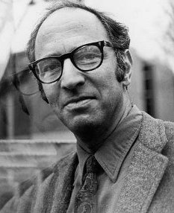
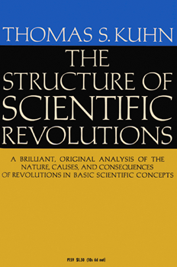
Thomas Kuhn
1922–1996
1962

Slide 18
The Kuhnian Model:
The Three Modes of Scientific Practice
Pre-normal science
“[A] number of distinct views of nature, each partially derived from, and all roughly compatible with the dictates of scientific observation and method.“ (p. 4)
- no consensus
- unstructured
- several competing schools
Normal science
“[The] scientific community thinks it has acquired firm answers to questions like the following: What are the fundamental entities of which the universe is composed? How do these interact with each other and with the senses? What questions may legitimately be asked about such entities and what techniques employed in seeking solutions?“ (p.4f.)
- defined by a paradigm
- consensus re: fundamental questions
- cumulative
- mature, successful
- to a certain extent dogmatic
Scientific revolution
“[T]he community‘s rejection of one time-honored scientific theory in favor of another incompatible with it.“ (p. 6)
- replaces an old paradigm with a new, incommensurable one.

Slide 19
Program for today‘s session
07/03/2019
Recapitulation of first session
3 modes of inference: deduction, induction, (abduction)
Hume’s problem of induction (incl. task 2)
The DN-model of explanation and the symmetry thesis
Darwin’s explanatory theory of evolution
Prediction in “irregular subjects”

Slide 20
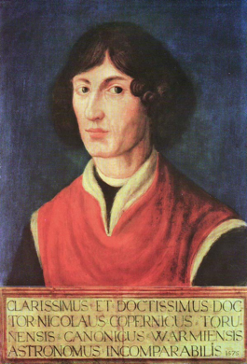
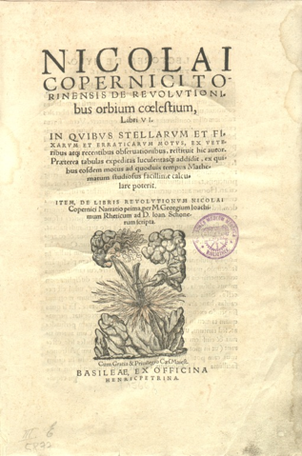
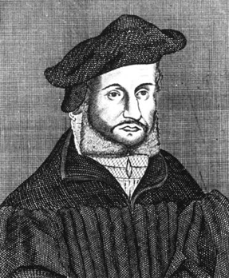
Osiander’s Foreword to
Copernicus’ De revolutionibus orbium coelestium (1543)
To the Reader Concerning the Hypotheses of this Work
There have already been widespread reports about the novel hypotheses of this work, which declares that the earth moves whereas the sun is at rest in the center of the universe. Hence certain scholars, I have no doubt, are deeply offended and believe that the liberal arts, which were established long ago on a sound basis, should not be thrown into confusion. But if these men are willing to examine the matter closely, they will find that the author of this work has done nothing blameworthy. For it is the duty of an astronomer to compose the history of the celestial motions through careful and expert study. Then he must conceive and devise the causes of these motions or hypotheses about them. Since he cannot in any way attain to the true causes, he will adopt whatever suppositions enable the motions to be computed correctly from the principles of geometry for the future as well as for the past. The present author has performed both these duties excellently. For these hypotheses need not be true nor even probable. On the contrary, if they provide a calculus consistent with the observations, that alone is enough.
Copernicus
1473 – 1543
Instrumentalism
Andreas Osiander
1498 – 1552

Slide 21
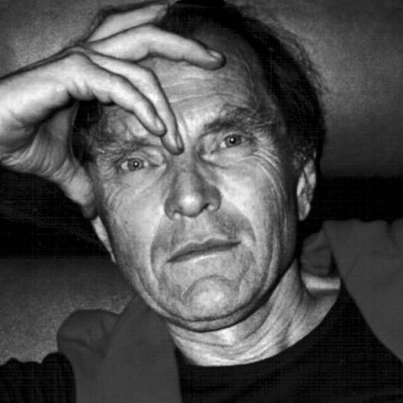
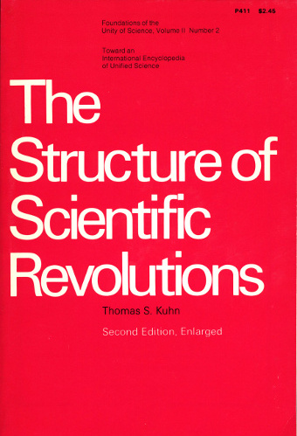
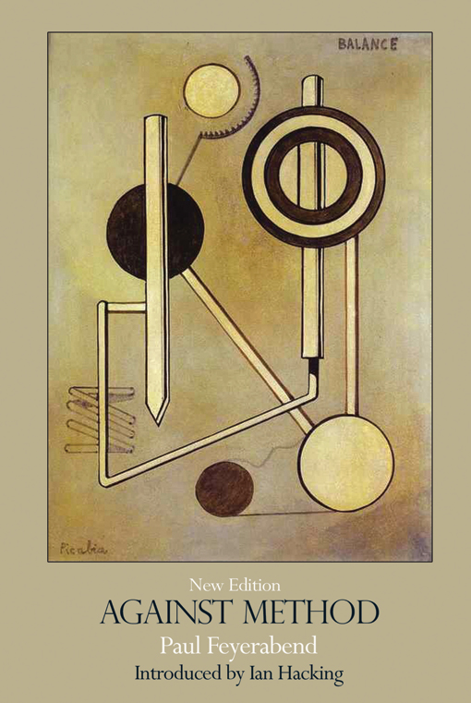
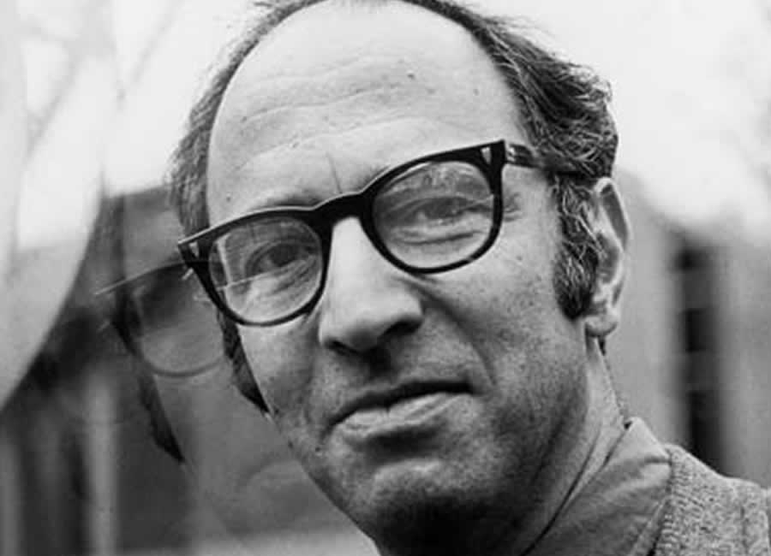
Incommensurability
Origin in mathematics: two numbers A and B are incommensurable if A/B is not a rational number.
Def. “incommensurable” Oxford English Dictionary: Not able to be judged by the same standards; having no common standard of measurement.
In phil. sci.: ‘Incommensurability’ denotes a specific type of incompatibility between theories/paradigms. The introduction of the term ‘incommensurability’ in phil. sci. is commonly attributed to Thomas Kuhn and Paul Feyerabend. (However, it is not widely known that the term was already used by Popper in the German edition of the Logic of Scientific Discovery.)

Slide 22
Incommensurability (cont.)
Kuhn: Difference in lexical structure of successive paradigms. Semantic variance in natural kind terms. No direct translatability.
Feyerabend: Ontological incompatibility between universal theories.
“[A] theory is incommensurable with another if its ontological consequences are incompatible with the ontological consequences of the latter”
Realism, Rationalism and Scientific Method. Philosophical Papers. Cambridge:
Cambridge University Press, p. xi.
Note: Successive theories can be incommensurable even if they use the same terms!

Slide 23
Examples of Incommensurability qua Difference in Lexical Structure (either meaning or reference incommensurability)
Matter waves vs. electromagnetic waves
The relativity of simultaneity
PRIONS (proteinaceous infectious particles )

Slide 24
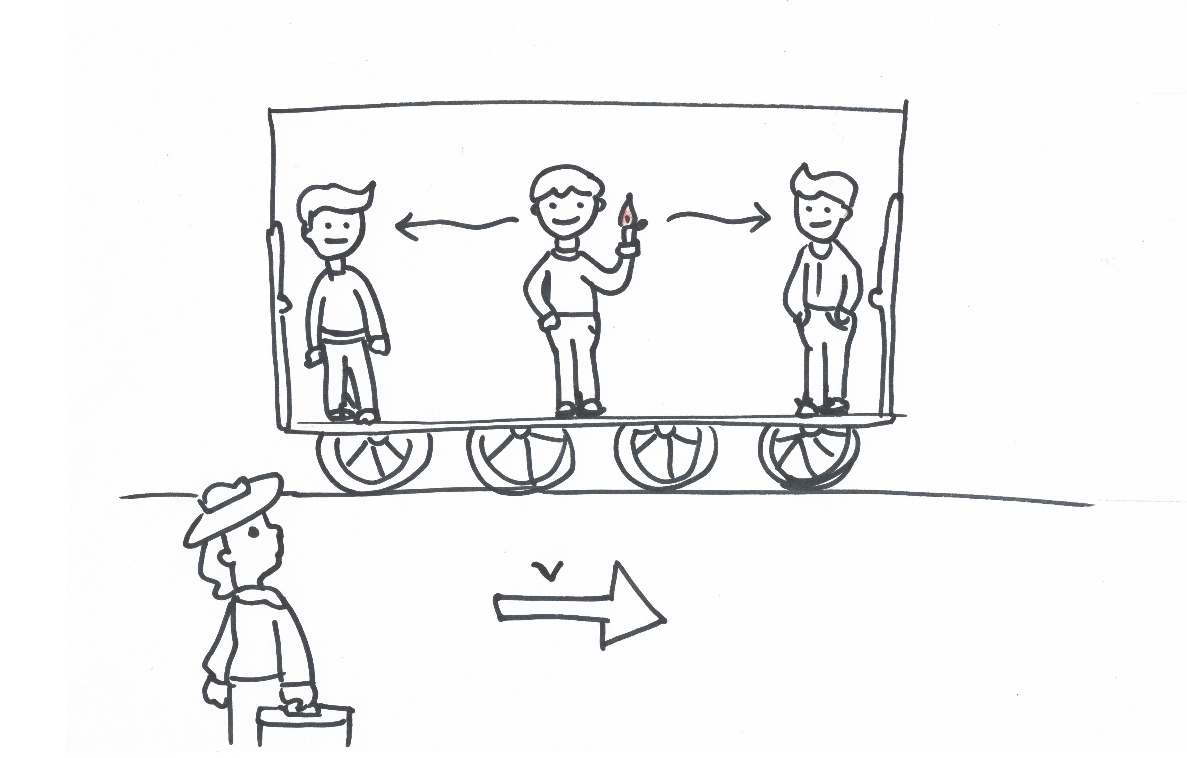
The Relativity of Simultaneity
In classical physics, time and space are absolute, and simultaneity is defined universally
In relativity theory, simultaneity is observer-dependent, i.e. two events may be simultaneous for some observers, but not for others.

Slide 25
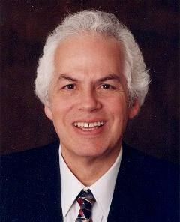
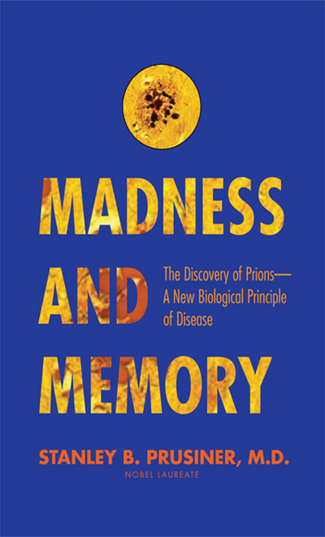
PRIONS (proteinaceous infectious particles)
Pre-1960s: transmissible diseases are caused by nucleic-acid containing pathogens.
1967: Tikva Alper and John Stanley Griffith formulate the “protein only hypothesis” for transmissible encephalopathies.
1982 Stanley Prusiner isoltates PRIONS. The concept of a nucleic acid-free pathogen is still heavily debated.
1997 Prusiner recieves Nobel Prize “for his discovery of Prions — a new biological principle of infection.”

Slide 26
Kuhn‘s Epistemic Virtues (or Values)
Accuracy
Consistency
Simplicity
Broadness of Scope
Fruitfulness
Kuhn’s account is based on …
… his model of scientific change
… a rejection of the context of discovery/justification distinction
... the insight that strict methodological rules are insufficient
Kuhn’s account reflects that …
… scientists make theoretical choices that are not fully determined by evidence
… values play a role in these decisions
... these values are “internal”, i.e. epistemic (and not moral, ethical, social etc.)
Accuracy

Slide 27
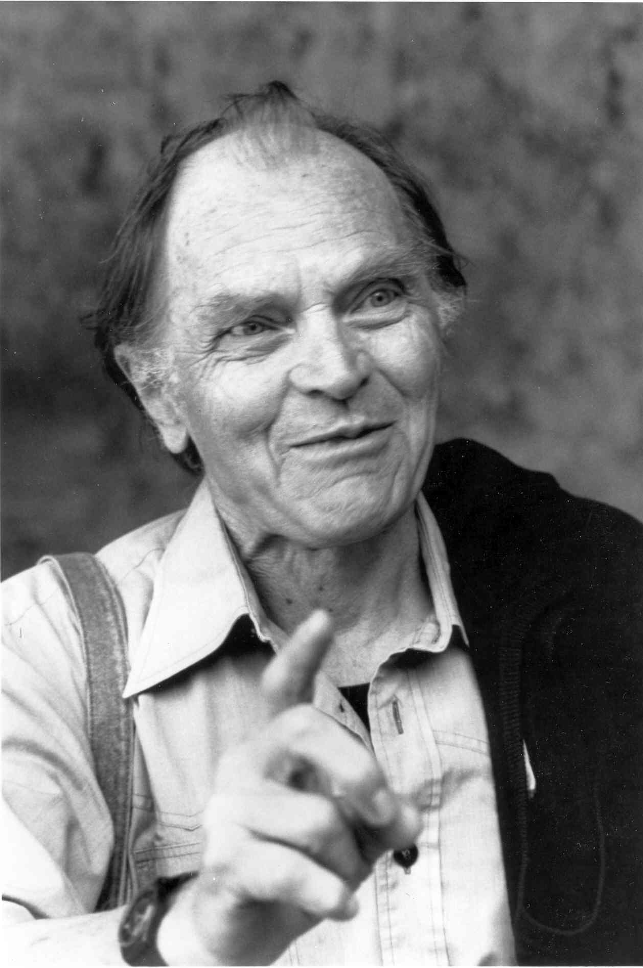

Paul Feyerabend’s anarchist methodology of science
“The idea of a method that contains firm, unchanging, and absolutely binding principles for conducting the business of science meets considerable difficulty when confronted with the results of historical research. We find, then, that there is not a single rule, however plausible, and however firmly grounded in epistemology, that is not violated at some time or other. We find, then, that there is not a single rule, however plausible, and however firmly grounded in epistemology, that is not violated at some time or other. It becomes evident that such violations are not accidental events, they are not results of insufficient knowledge or of inattention which might have been avoided. On the contrary, we see that they are necessary for progress.” AM, Introduction
Paul K. Feyerabend
1924–1994
Against Method: Outline of an Anarchistic Theory of Knowledge
1975

Slide 28
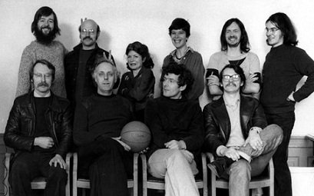
The Strong Program in the Sociology of Knowledge (The Edinburgh School)
Members of the Science Studies Unit at the University of Edinburgh in the early 1980s
Back row, left to right: Mike Barfoot, Steven Shapin, Carole Tansley, Moyra Forrest, Andy Pickering, Dave Smith. Front row: David Bloor, David Edge, Barry Barnes, David Miller.
Picture taken from http://www.stis.ed.ac.uk/ssu50

Slide 29
The Four Principles of the Strong Program
Causality: it examines the conditions (psychological, social, and cultural) that bring about claims to a certain kind of knowledge.
Impartiality: it examines successful as well as unsuccessful knowledge claims.
Symmetry: the same types of explanations are used for successful and unsuccessful knowledge claims alike.
Reflexivity: it must be applicable to sociology itself.
Cf. David Bloor, Science and Social Imagery (1976)

